Slide 1
Modern Trends in SDA Organization

Slide 2
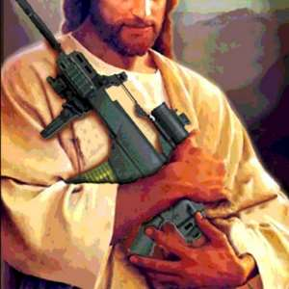
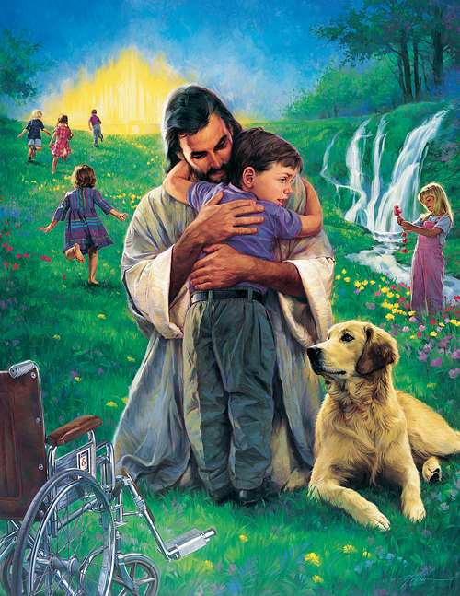
Deadly Force Incidents (DFI)
1705 case in religious Organizations
11 in Adventist Institutions (9 years)

Slide 3
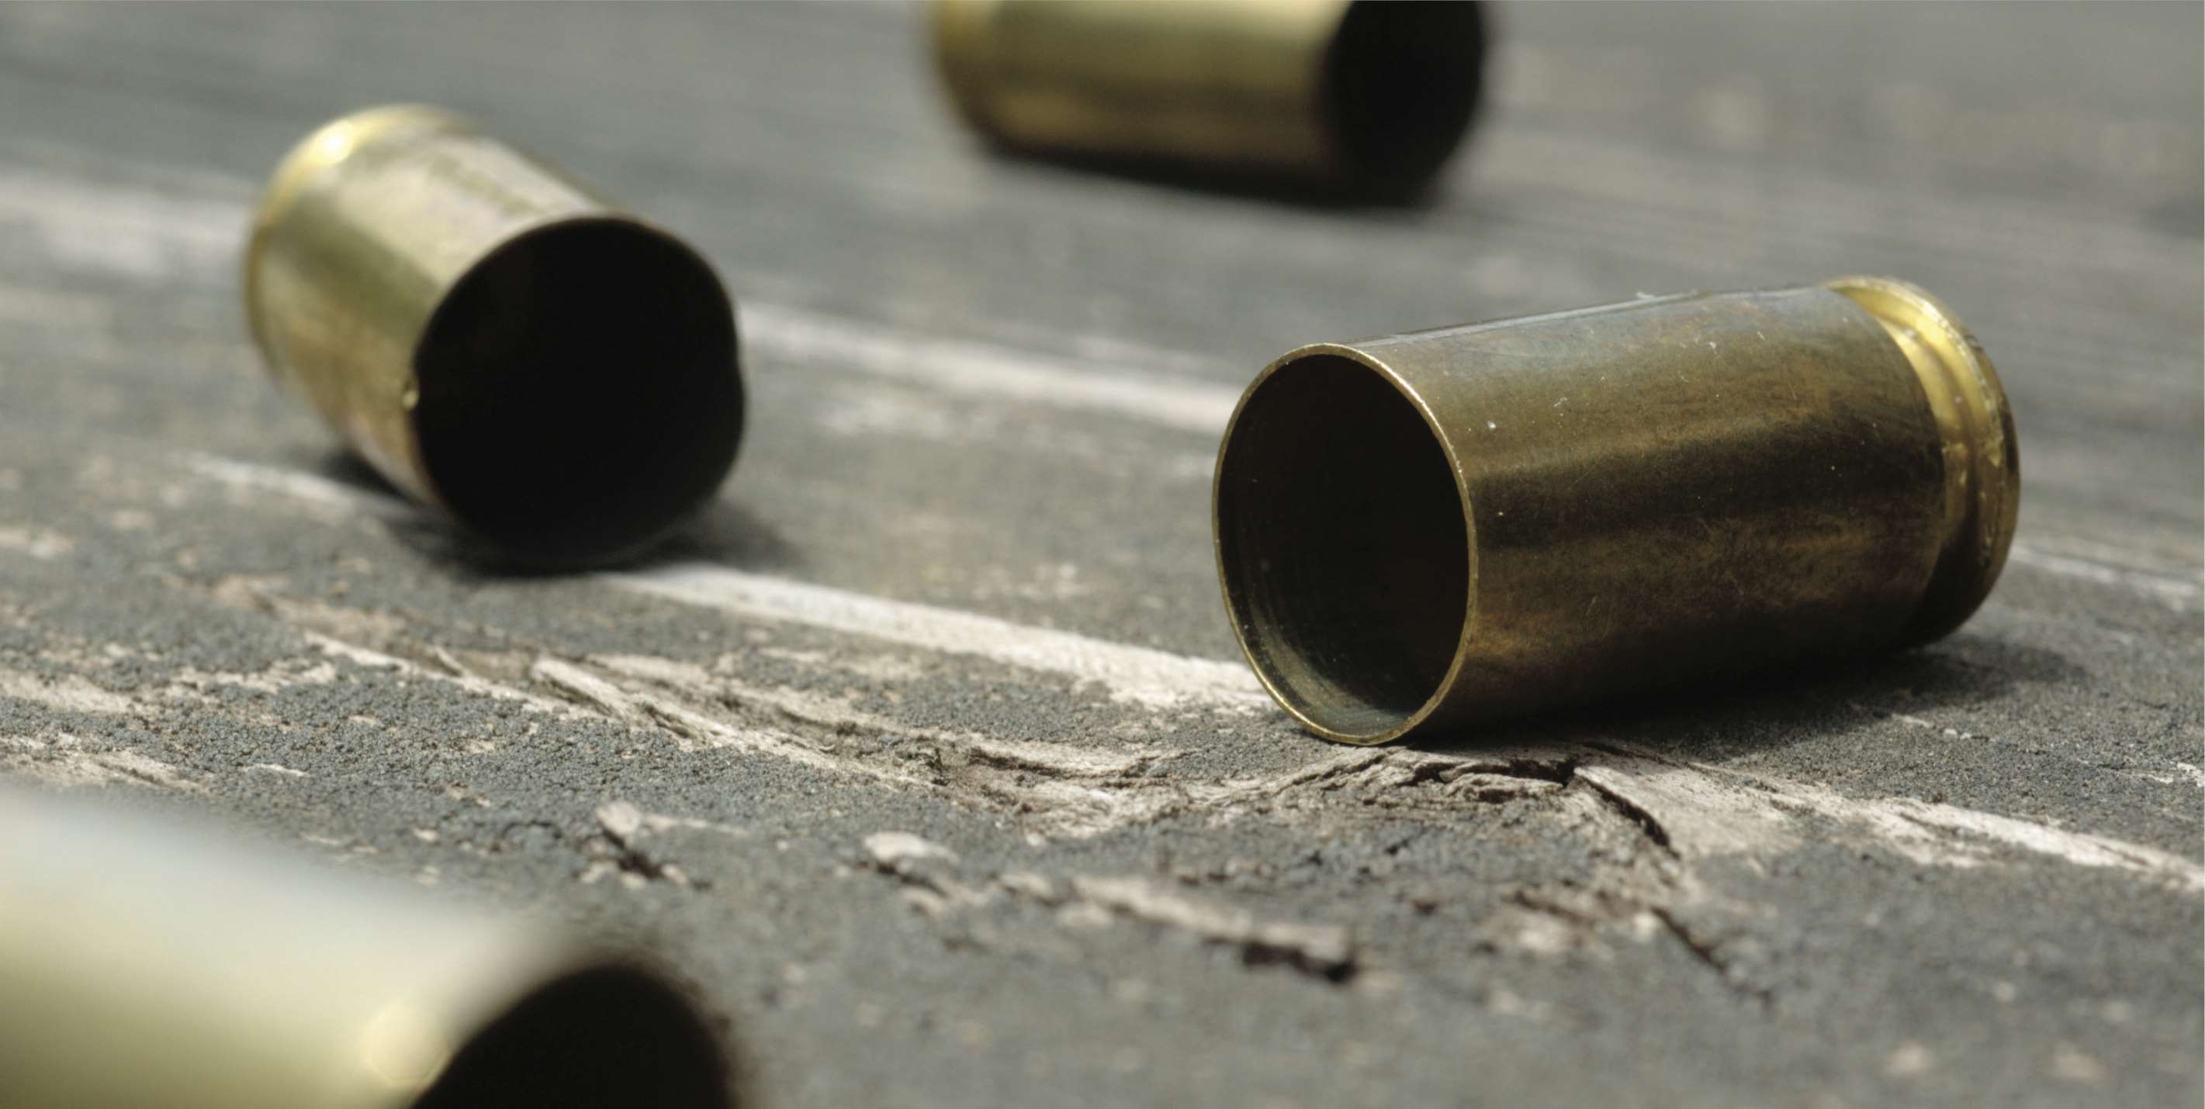
Current Debate
Guns do not commit crimes, but people do
Violence and criminal inclinations lead to guns
Availability of guns leads to violence
Possession of guns has increased by 300% in 4 years

Slide 4
Top Pro & Con Arguments
Pro
Con
Concealed handguns deter crime
Responsible citizens should arm themselves
law-abiding and do not misuse their firearms
Americans support allowing the concealed carry of handguns
Concealed handguns increases crime
handgun increases confrontation
background checks do not prevent acquiring weapons
Concealed weapons laws make the non-carrying public feel less safe

Slide 5
What are Adventist Doing?
Camp safety
Church safety
Pathfinders Safety
School Safety
One Sabbath, One Drill, A Safer Church.
The Safety Officer
Emergency Planning
RUN! HIDE! FIGHT!

Slide 6
