Slide 1

Starting Right
Elias F Zabala Sr.
Treasurer, Atlantic Union

Slide 2
“God would rather place us in the crockpot instead of the microwave.”
John Maxwell

Slide 3
Understanding Leadership
What is leadership?
Why is leadership important – why do we need leaders?
Leaders – born or bred?

Slide 4

"Leadership is a function of knowing yourself, having a vision that is well communicated, building trust among colleagues, and taking effective action to realize your own leadership potential."
Prof. Warren Bennis

Slide 5

Leadership
Moves from the internal to the external
First it’s personal then public
Intra-personal then Inter-personal
Starts with me then goes to others
Lead yourself, before pretending to lead other

Slide 6

Scope of Leadership
Personal
Domestic
Community
National/International
Notes:
Personal domestic community national

Slide 7
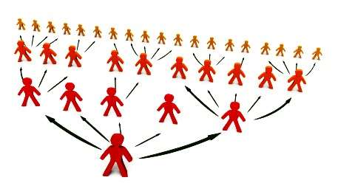
The 20% Principle

Slide 8
The 20% Principle
The 20% produce the 80% of the results
The 20% does the 80% of the work
The 20% gives the 80% of the Money

Slide 9

Individual Exercise
Choose a leader YOU admire (in your mind)
What personality traits and skills do they have?

Slide 10

Leadership Traits
Adaptable to situations
Ambitious and achievement orientated
Assertive
Cooperative
Decisive
Dependable
Energetic (high activity level)
Persistent
Self-confident
Willing to assume responsibility

Slide 11
Leadership Skills
Clever (intelligent)
Conceptually skilled
Creative
Diplomatic and tactful
Fluent in speaking
Knowledgeable about team task
Organised (administrative ability)
Persuasive
Socially skilled

Slide 12

Most Important Traits for leaders
Leadership Humility -The Surprising X-Factor for Leaders
Effective Communication – The Trait Most Leaders Get Wrong
On-Purpose Self Development – A Professional Game-Changer

Slide 13
Words often used to describe ineffective leaders
How many of them come directly from:
lack of leadership humility
poor communication
lack of self development

Slide 14

Out
Of
Touch
Arrogant
Selfish
Incompetent
Covfefe
Inconsistent
Not
Trustworthy
Condescending
Egotistical

Slide 15

Exercise In pairs
Discuss examples you have come across of strong and weak leadership
You can use examples from employment, academic studies or participation in sports clubs, church, etc (keep anonymous)

Slide 16
Leader Responsibilities
Guide/coordinate team members – encourage teamwork and motivate individuals
Provide structure for team – set mission and purpose, clarify roles and responsibilities, allocate tasks and set objectives
Clarify working methods, practises and protocol
Focus on performance – anticipate challenges, monitor performance, delegate and provide support

Slide 17
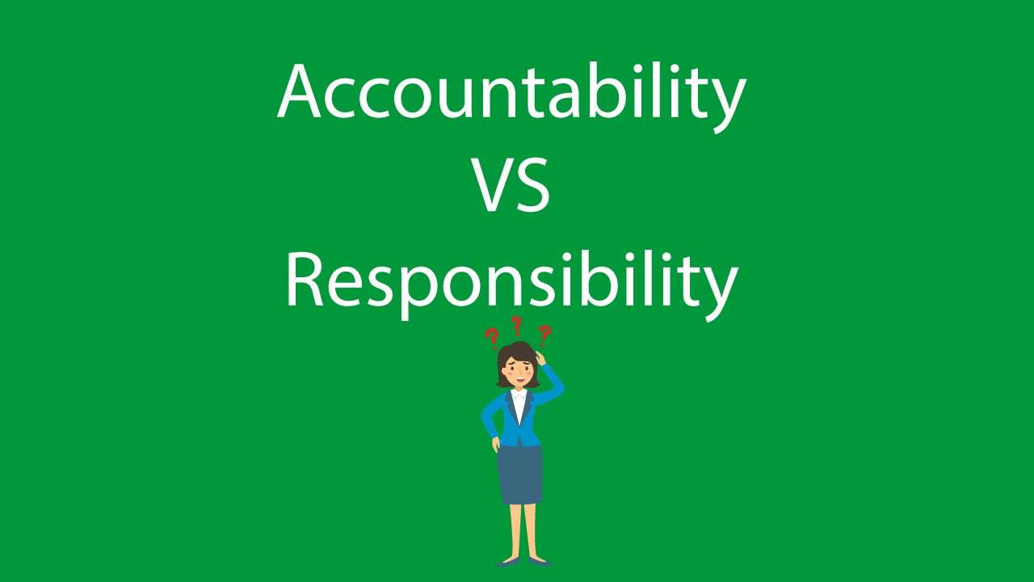

Slide 18
Accountability
Accountability the state of being accountable, liable, or answerable
Accountability can not operate fairly without the leader being given full authority for the responsibilities concerned
Accountability breeds response-ability. Stephen Covey

Slide 19
Responsibility
Responsibility can be delegated, accountability can not be.
A good leader accepts ultimate responsibility

Slide 20

What does having authority mean?
Authority is the power to influence or command thought, opinion or behaviour

Slide 21
What do Leaders actually do?
Envision-clear view, compelling, inspired, dream, bigger picture of tomorrow, where we going
Enlist- Getting other involved, support, etc
Embodying-How you treat people, stand for what you believe

Slide 22
What do Leaders actually do?
Empowering-Decision making, equip, knowledge, training, coaching
Evaluate-People, contribution, skills, needs, progress, ethics ask why, honest feedback
Encourage-Be the champion, cheerleader, share your passion, lift people up, stay solid, positive

Slide 23

Leader’s Inventory
Have you ever broken a bad habit?
Do you keep self control when things go wrong?
Do you think independently?
Can you handle criticism?
Do you welcome responsibility?

Slide 24
Leader’s Inventory
Are you a peacemaker?
Do people trust you with difficult and delicate situations?
Can you accept opposition?
Can you make and keep Friends?

Slide 25
Leader’s Inventory
Do you get nervous in the presence of your superior?
Are you interested in people? All types? All races? No prejudice?
Are you Tactful?
Can you forgive?
Are you reasonably optimistic?

Slide 26

Great Leaders Grow
Gain Knowledge
Reach Out to Others
Open Your World
Walk toward Wisdom

Slide 27
Gain knowledge
Know your strengths and weaknesses
Know the people you lead (personally and professionally)
Know your industry extremely well
Master the principles and practices of leadership
Develop a detailed personal plan

Slide 28
Reach out to others
Invest in growing others
Mentor relationships with emerging leaders
See and seize teachable moments
Share what you learn with other
Develop ways to communicate your point of view

Slide 29
Open your world
Look for opportunities to grow each day
Seek new experiences outside your workplace
Find a mentor to help you grow
Look for opportunities to lead
Engage in a sport or hobby you like

Slide 30
Walk toward wisdom
Tell yourself the truth about your leadership
Actively seek feedback from truth-tellers
Have a group of people to counsel you on important issues
Master the art and discipline of asking questions
Commit yourself to a pursuit of wisdom

Slide 31

How to lead when you are not the leader
Be a pulse taker.
Be a vision amplifier. Repeat, clarify and reinforce the vision.
Be a leader multiplier. Identifying and recruiting other leaders
Be a gap filler. Simply stated, when an important job needs to be tackled in a dynamic organization, the first chair looks for a trusted second chair to get it done.

Slide 32

On promotion
Your ability to handle offense will determine your direction for the next 30 years.
God will promote you to the level of your tolerance of pain.
In the corporate world the people who are paid the big buck are paid to handle problems.
There is nothing worse than putting a little person on a big position.

Slide 33
On promotion
To him who much is given much is required.
New levels, new devils
Leaders don't get to chose their own crisis
You are never wrong to do the right things
The journey is as important as the destination
Becoming a leader, doesn't make you someone else, it shows who you are

Slide 34

Don't count people out because of their age, ethnicity, gender

Slide 35
Do not draw a map of where you will like to serve

Slide 36
The safest place is where God want you

Slide 37
If you don’t know where to start, go to where people are

Slide 38
Avoid distorted views of God's work

Slide 39
Think before acting or speaking

Slide 40
Move on. If you have to fight to keep your Job, you already lost it

Slide 41
Show commitment even in difficult times.

Slide 42
“God would rather place us in the crockpot instead of the microwave.”
John Maxwell

